Slide 1


GRADE 8 ICT/DESIGN
Lesson 1: Programming for a Purpose (Code.org 3b)
Ms. Abboud • Grade 8 - ICT/Design • Term 1, Week 8

Slide 2
Learning Objectives
WALT - We Are Learning To
WILF - What I'm Looking For
Match animations and games to the needs of users.
Plan a design for a user with the problem-solving process.
Each design is matched to a user with a clear reason.
My own design shows who it is for and what it does.

Slide 3
Academic Vocabulary
Problem-Solving Process
Game Lab
Steps for working through a problem: define, prepare, try and reflect.
The Code.org tool where we write code to make drawings, animations and games.

Slide 4
Frayer Model: Problem-Solving Process
DEFINITION
CHARACTERISTICS
Steps for working through a problem: define, prepare, try and reflect.
A cycle you can repeat; you plan before you build and test after.
PROBLEM-SOLVING PROCESS
EXAMPLES
NON-EXAMPLES
Define who the game is for, sketch a plan, build it, then improve it after testing.
Starting to code with no plan and never testing it.

Slide 5
National Identity Integration
UAE value of considering others: good designers start with the person they are designing for, the way UAE public services are designed to include people of determination. Today every design starts with a user.

Slide 6
STARTER
Warm Up: Word Search
Complete the Problem Solving Word Search.
Which steps of the problem-solving process can you remember?
Hook • Engage & Ask
5 - 10 minutes

Slide 7
LESSON CORE
I Do: A New Unit
New unit: Interactive Animations and Games, built in Game Lab.
Every project follows the problem-solving process: define, prepare, try, reflect.
Gradual Release of Responsibility
35 - 45 minutes
1 / 3

Slide 8
LESSON CORE
We Do: Who Is This Game For?
Look at different animations and games.
Match each one to a user and give a reason: 'This suits ___ because ___.'
Gradual Release of Responsibility
35 - 45 minutes
2 / 3

Slide 9
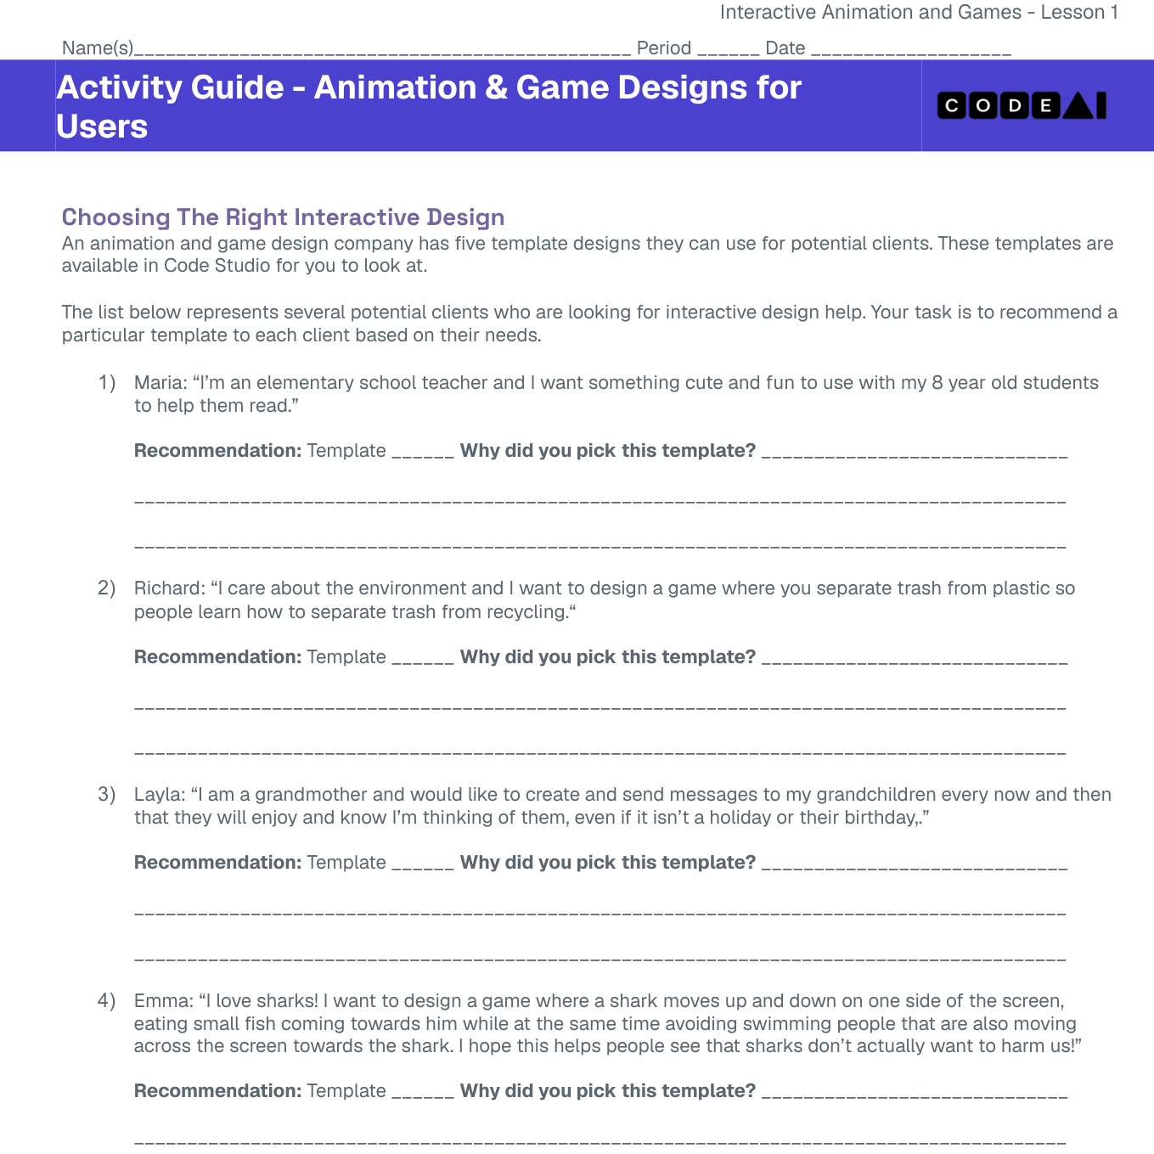
LESSON CORE
You Do: Design for a User
Complete Animation and Game Design for Users.
Choose a user and sketch a design for them on the Design Template.
Code.org activity: Animation and Game Design for Users
Gradual Release of Responsibility
35 - 45 minutes
3 / 3

Slide 10
CLOSURE
Exit Ticket
Which part of your design was decided by your user's needs?
Transition & Extend
5 - 10 minutes

